Slide 1




How can population data science big health data make an impact on health(care) system(s)?
Andriy Koval
Health System Impact Fellow
Notes:
Whatever you call it
The question is very ambiguous, It’s a Rorchach test: it matters what it makes you think about.

Slide 2
Plan for today
A sketch to set the stage
5 things
2 graphs
5 things again

Slide 3


20 years ago
EHR Developers:
- Make your records digital and bask in clinically actionable knowledge!
Public:
- OK
Today
Public:
- So what about basking in clinically actionable knowledge?
EHR Developers:
- Err… It turns out, EHR data is usually complex, frequently unstructured, and most of the time missing. And while making sense of it is often problematic and unreliable, do not worry, artificial intelligence will come to our rescue!
http://villains.wikia.com/wiki/Bender_Bending_Rodríguez?
Notes:
Why? Because data collection is too far removed from knowledge application

Slide 4
The promise of big clinical data remains largely UNFULFILLED

Slide 5
How can population data science big health data make an impact on health(care) system(s)?
What features of data science
What creative skills
What concepts
are important* to help fulfill this promise?
*in my opinion
Notes:
And in light of that statement, let me re-interpret the question

Slide 6
How can population data science big health data make an impact on health(care) system(s)?
Stated less optimistically:
IF there is any impact, what* would be responsible for it?
*in my opinion
Notes:
If there is an impact, what will contribute to it?

Slide 7
Plan for today
A silly sketch to set the stage
5 things
2 graphs
5 things again

Slide 8
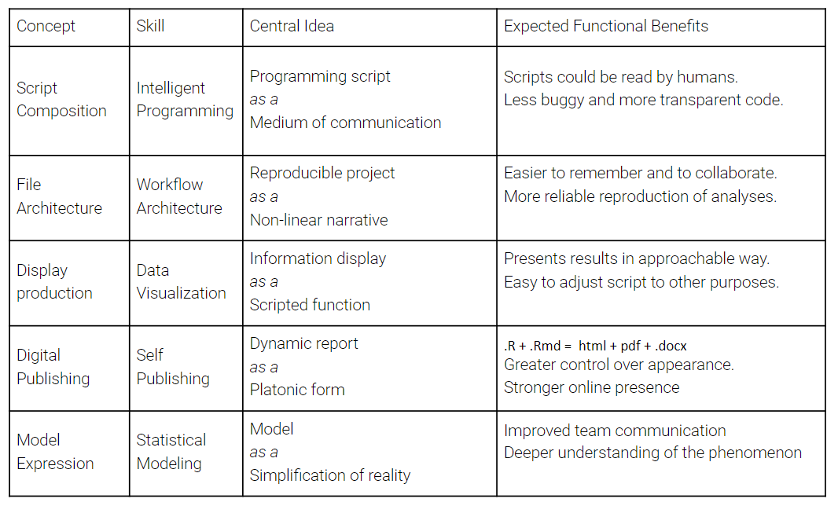
TL;DR
Hone these skills: this is applied health data science*
* In my opinion

Slide 9
Plan for today
A silly sketch to set the stage
5 things
2 graphs
5 things again

Slide 10
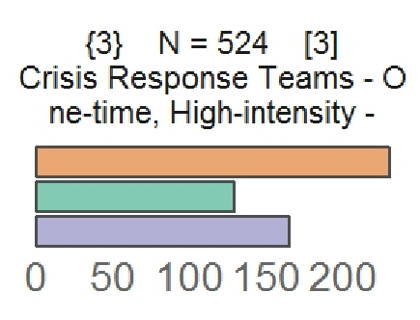
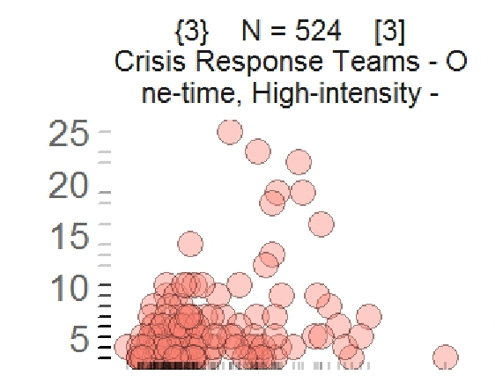

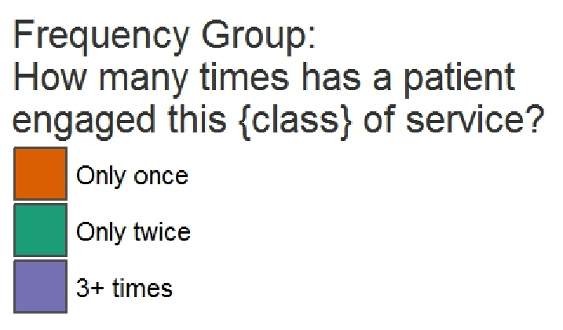

Consider that there is a cohort of patients ( N = 1,304 ) who have been identified as having a form of SCHIZOPHRENIA.
How were they using health services?
Which classes?
How often?
Notes:
Consider that there is a cohort of patients, who are similar with respect to there diagnostic grouping. For example, all have a form of
SCHIZOPHRENIA, as our example will demonstrate.
Let us examine the pattern of engaging a particular class of health services using clinical encounter data over the span between 2007 – 2017 in Vancouver Island Authority. We identified 1,304 patients.

Slide 11
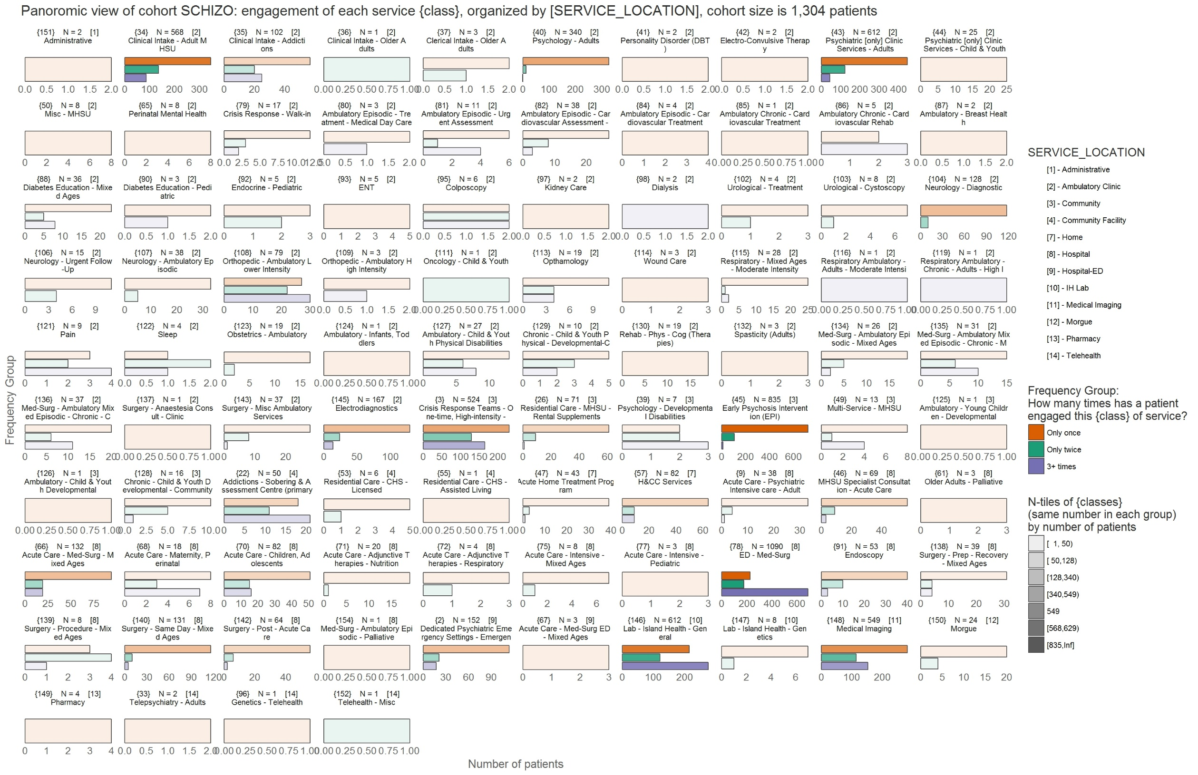

Slide 12
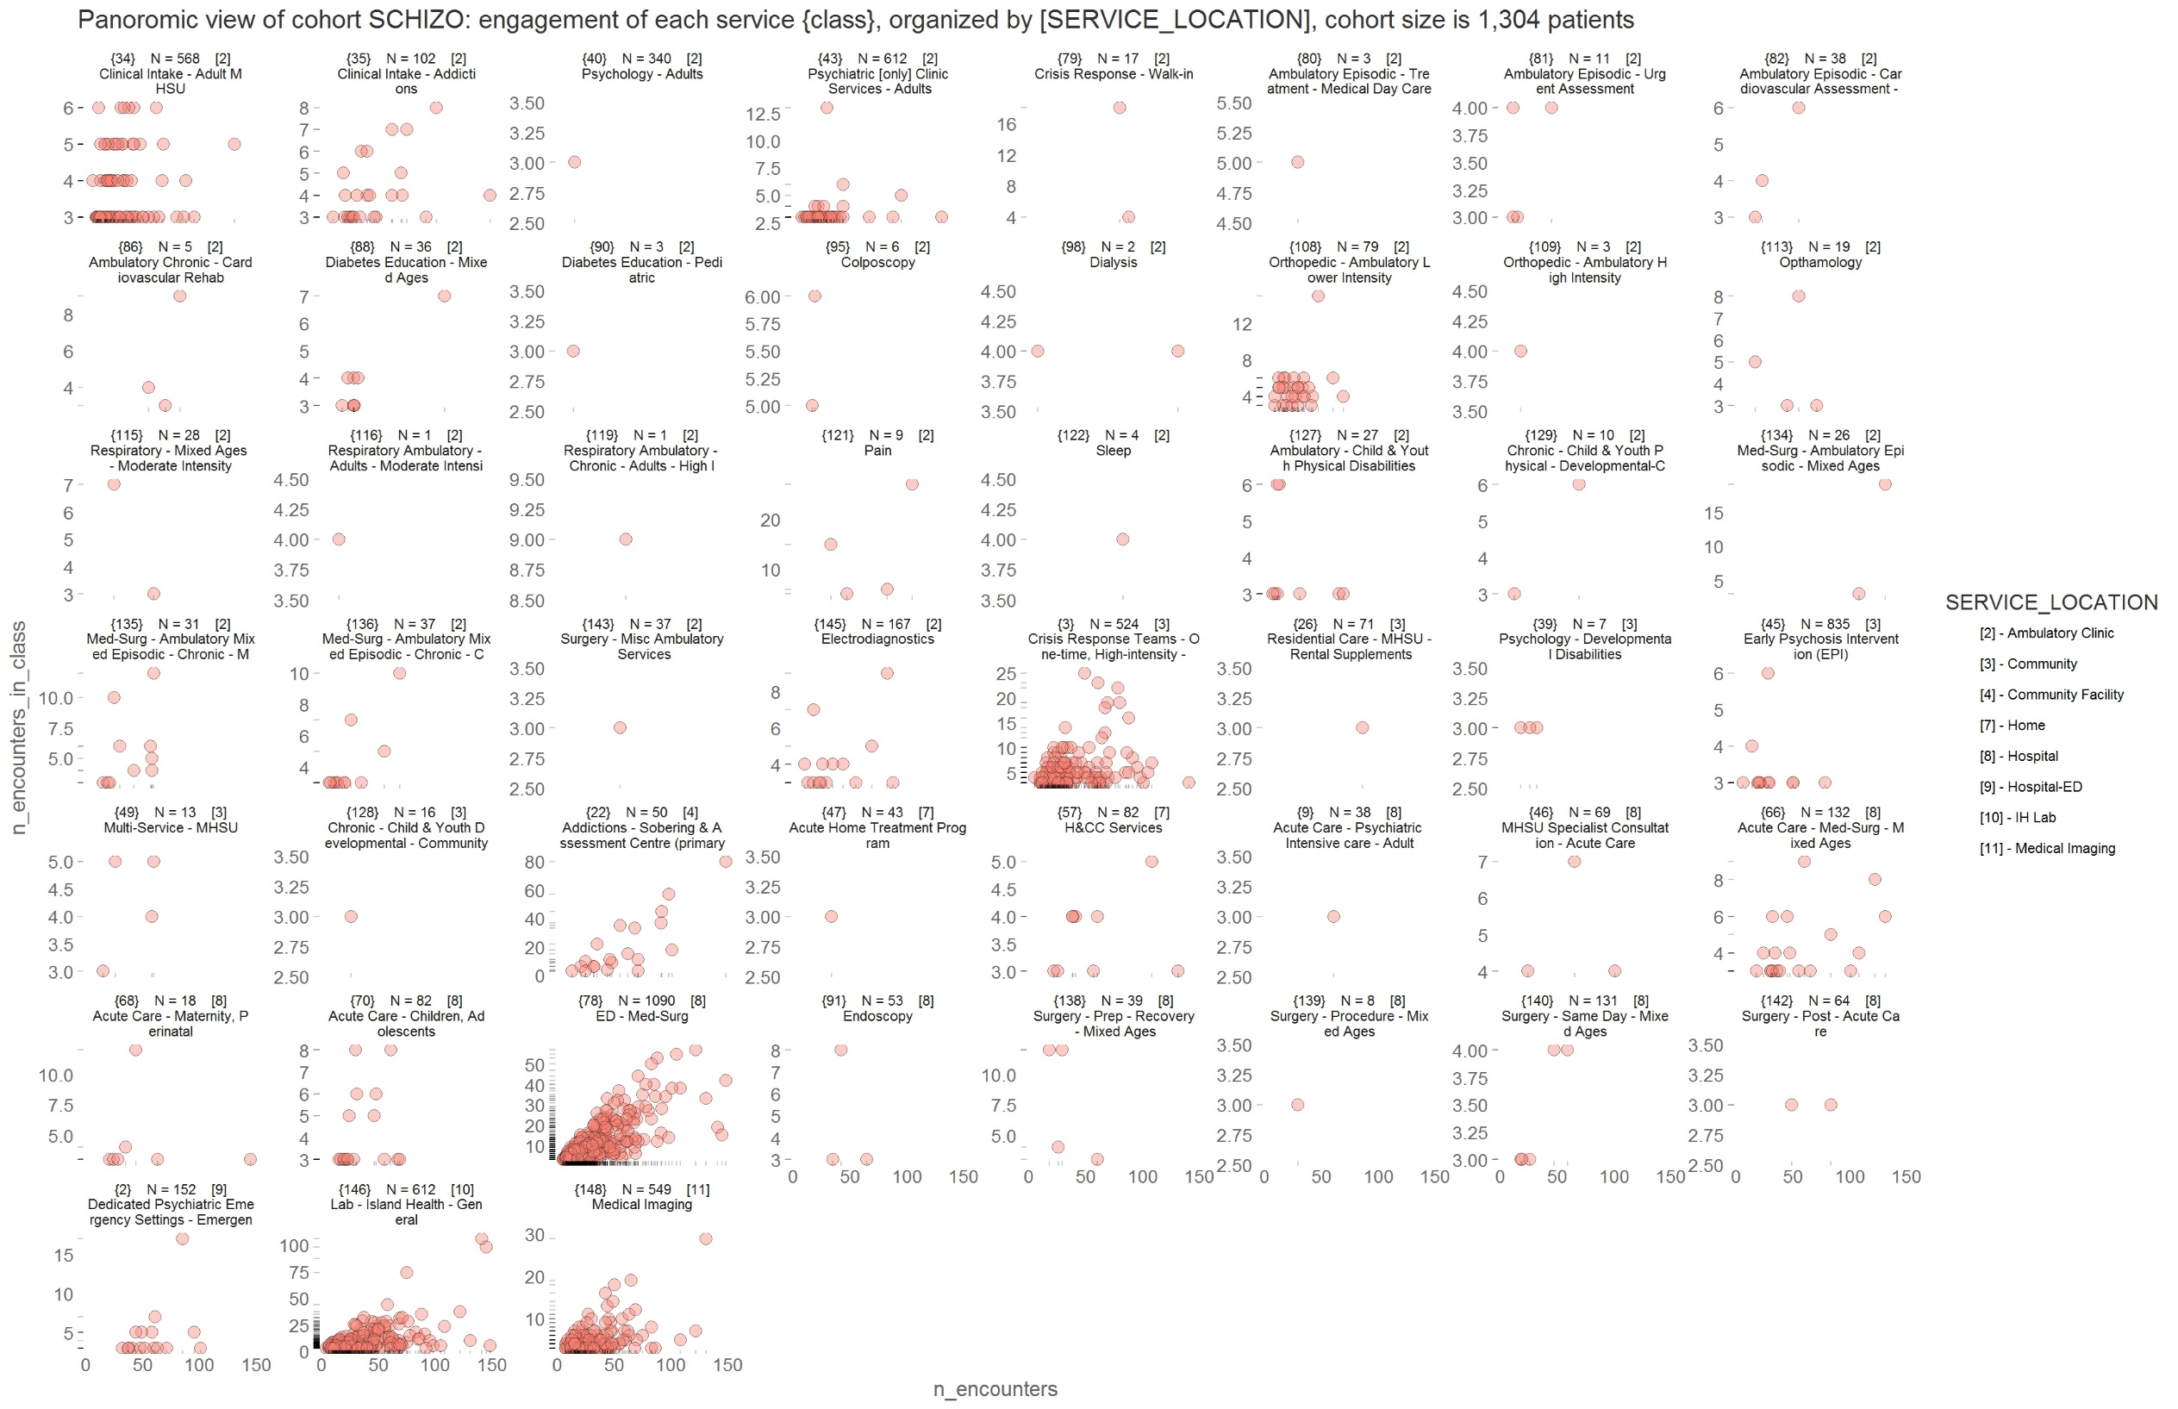

Slide 13
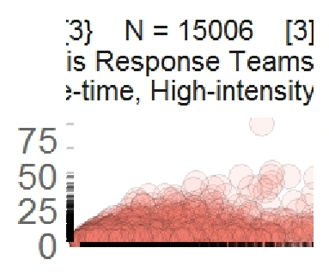

Slide 14
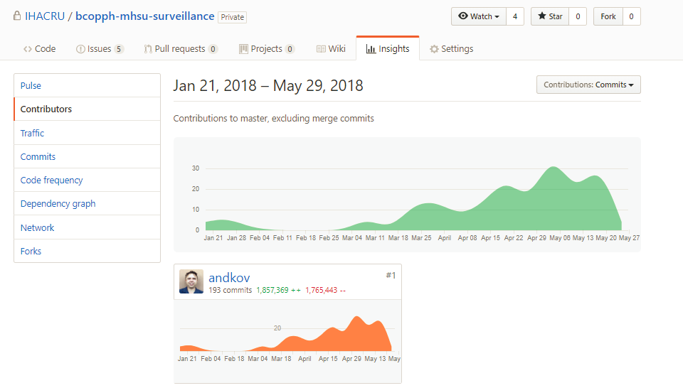

Slide 15
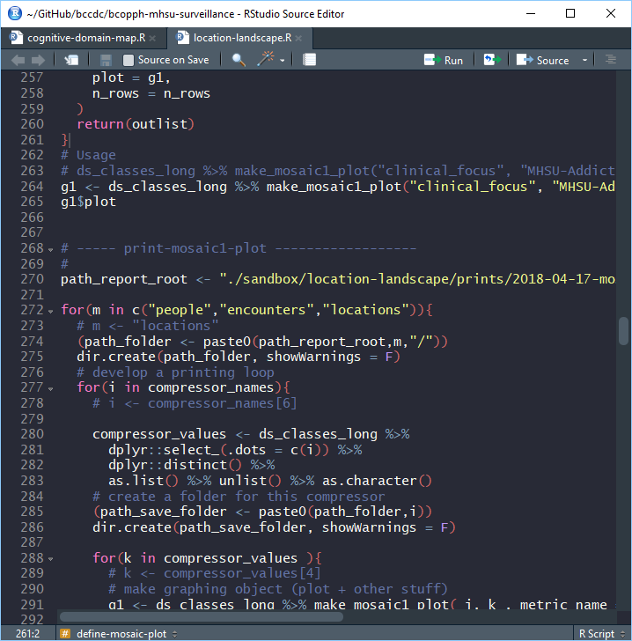
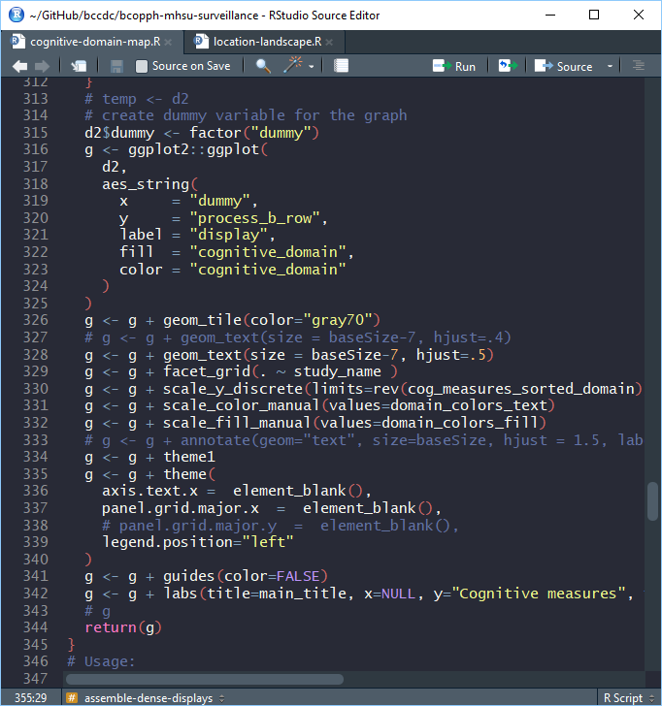
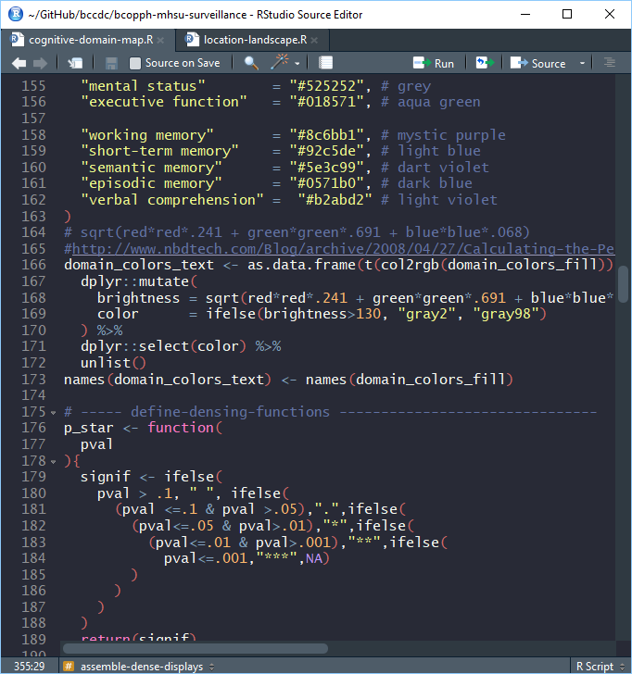
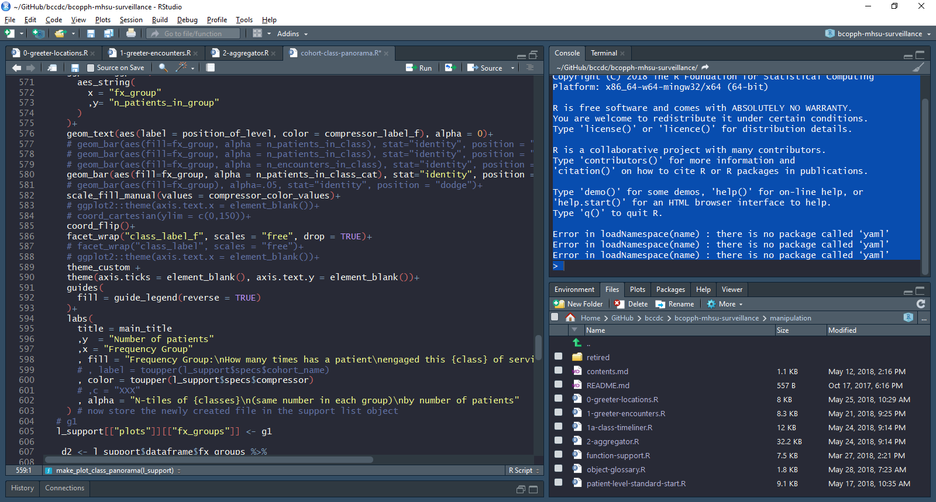
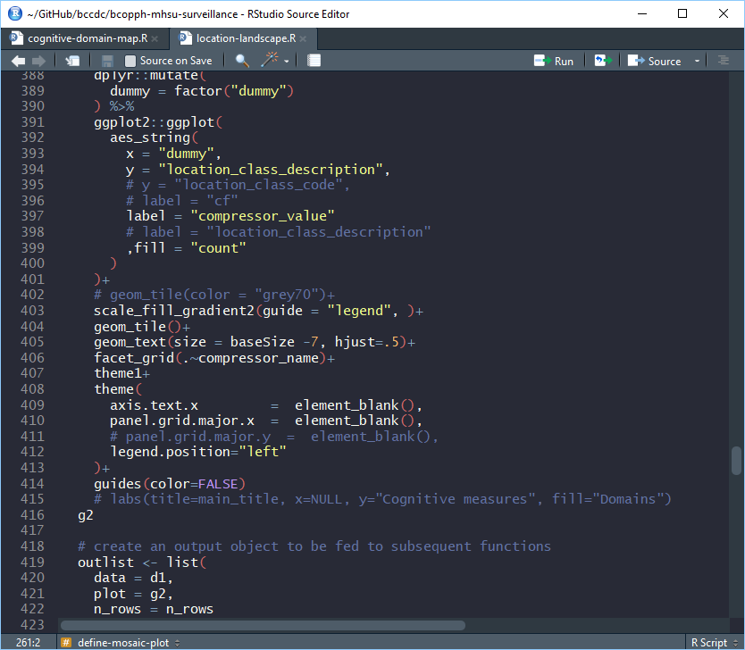

Slide 17



Acknowledgements
Health System Impact Fellowship
Kate Smolina
Ken Moselle

Slide 18
Appendix

Slide 19
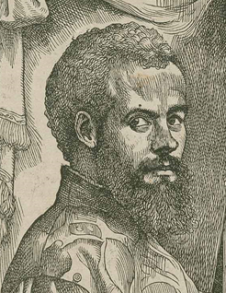
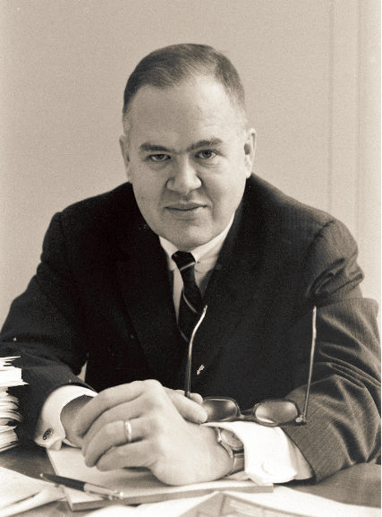


Shoulders to stand on
Andreas Vesalius
John Tukey
Edward Tufte
Hadley Wickham
Notes:
Tukey: https://artsandculture.google.com/entity/m025r9k

Slide 20
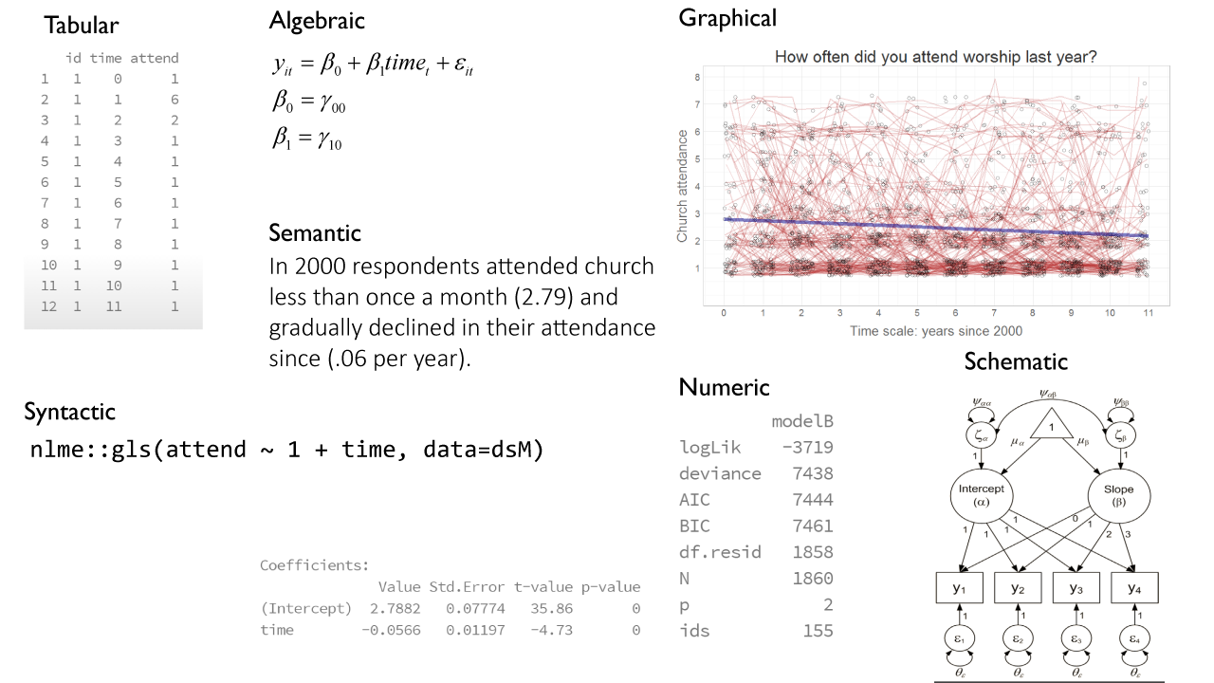
Model Manifestations

Slide 21
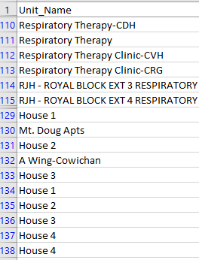
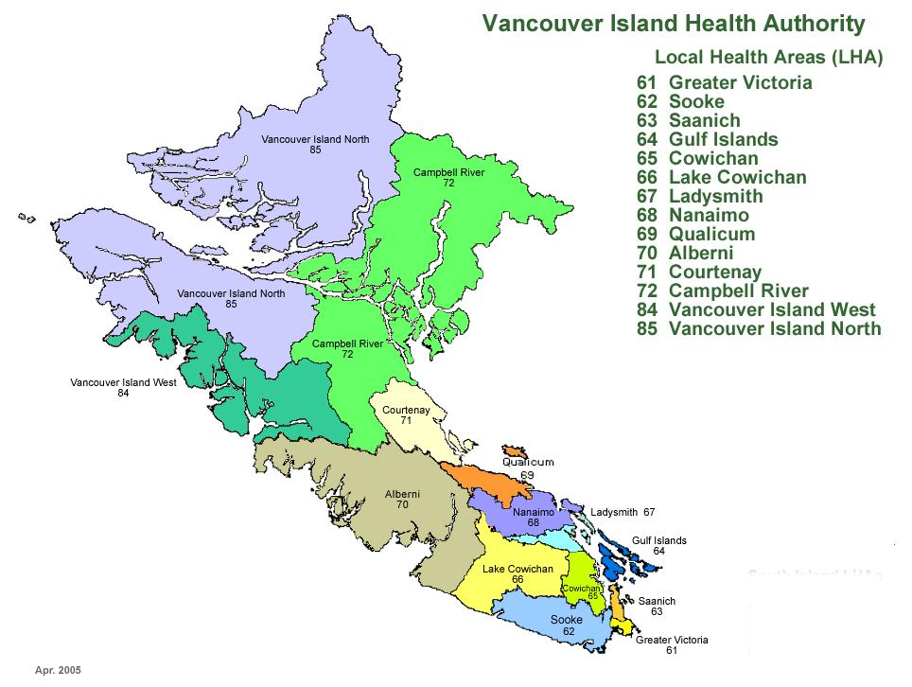
Vancouver Island Health Authority
Examples of service locations
Why bother with
transactional data?
VIHA is a collection of 2300+ individual programs, dispensing health services. Implemented in 2007, a CERNER-powered EHR spans the entire universe of service locations that constitute VIHA. However, location data is “dirty” : frequently it’s hard to make out and categorize the nature of the services offered at each location.
Source: https://midwifery.ubc.ca/student-portal/midwifery-clinical-placements/about/vancouver-island-health/
Ken Moselle
2007
2008
2009
2010
2011
2012
2013
2014
2015
2016
2017
2018
2016

Slide 22
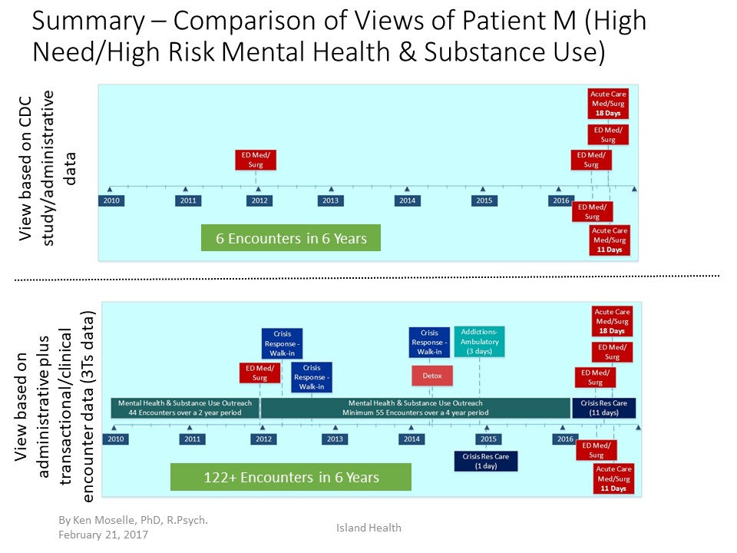
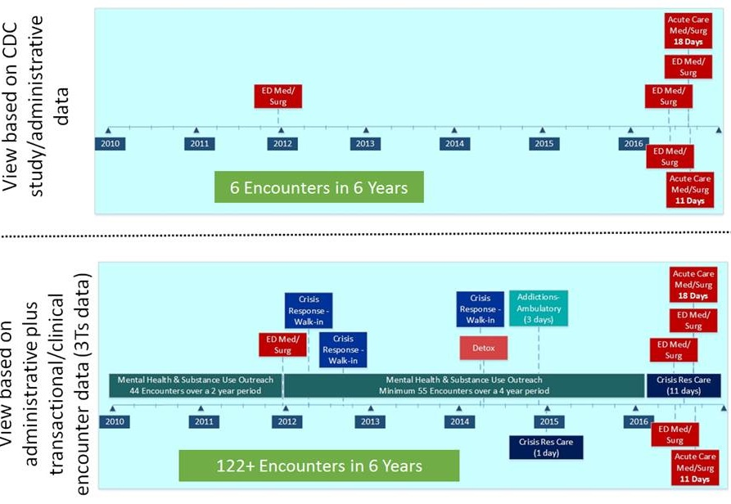
Vancouver Island Health Authority
Research relying ONLY on Acute + ED data sources may be overlooking a substantial portion of patients’ clinical history.
Patients’ interaction with health services may offer a glimpse into a brewing crisis that otherwise would have been missed by administrative data.
I join Ken to create a learning system for mapping the full-spectrum cross-continuum space of health services at VIHA onto a smaller set of descriptive labels: Clinical Context Coding Scheme (CCCS)
View based on
ED + Acute Care data
Here is why
View based on
administrative plus
transactional/clinical
encounter data (3Ts data)
Ken Moselle
2007
2008
2009
2010
2011
2012
2013
2014
2015
2016
2017
2018
2016

Slide 23
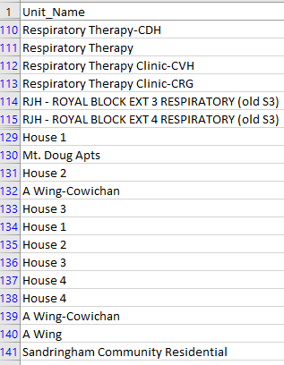
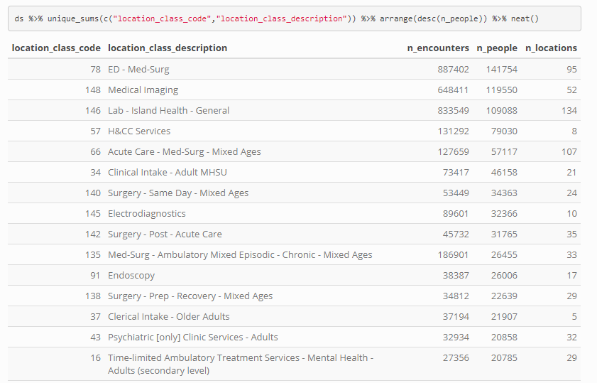
github/ihacru/ihacru-location-census
Clinical Context Coding Scheme (CCCS) organizes the processes of (1) identifying service features of each location and (2) grouping individual locations into a class of locations based on similarity of these features.
Health Service Location
Location Class
N = 2300+
N = 150+
Ken Moselle
2007
2008
2009
2010
2011
2012
2013
2014
2015
2016
2017
2018
2016

Slide 24
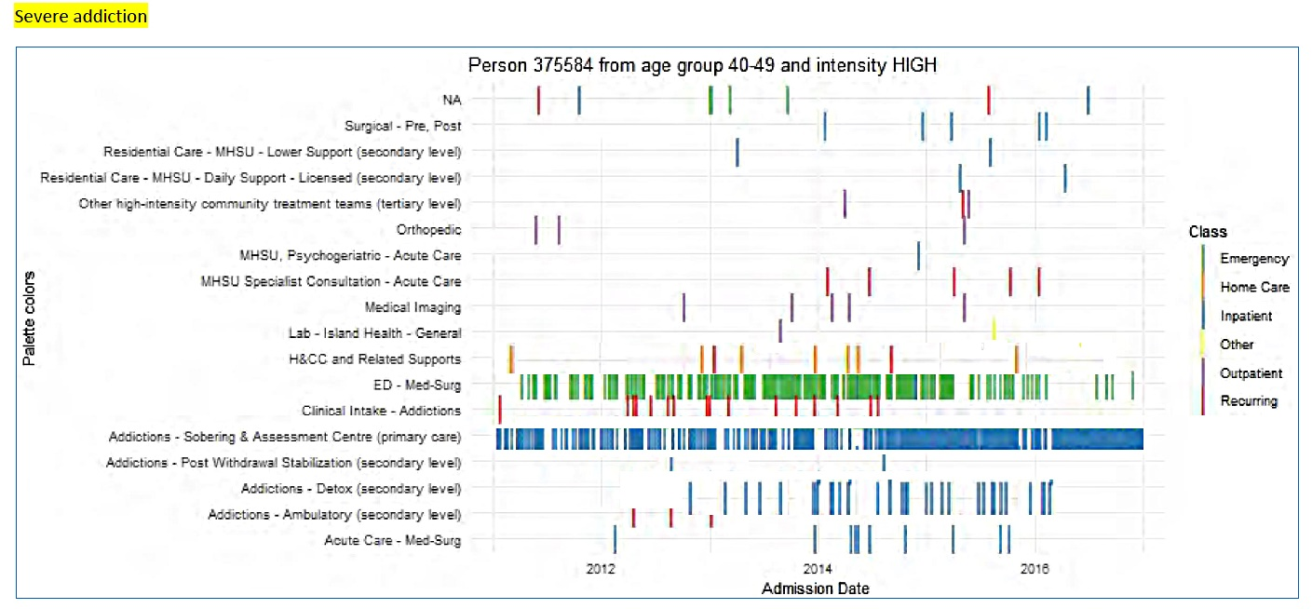
Aggregating individual service locations into homogeneous location classes allowed manageable rendering of clinical landscapes: a complete history of person’s interaction with health services. This image forms the focal point of my methodological interest: I want to express mathematically and evaluate statistically constellations of person’s engagements with healthcare system.
This is a fictional composite visualization based on data from several patients, cut and reassembled (Photoshop) to create an image that is representative of a single individual patient ‘journey’ through the array of secondary and tertiary services, but not actually reflecting at a row level the data of any patient.
Ken Moselle
2007
2008
2009
2010
2011
2012
2013
2014
2015
2016
2017
2018
2017

Slide 25
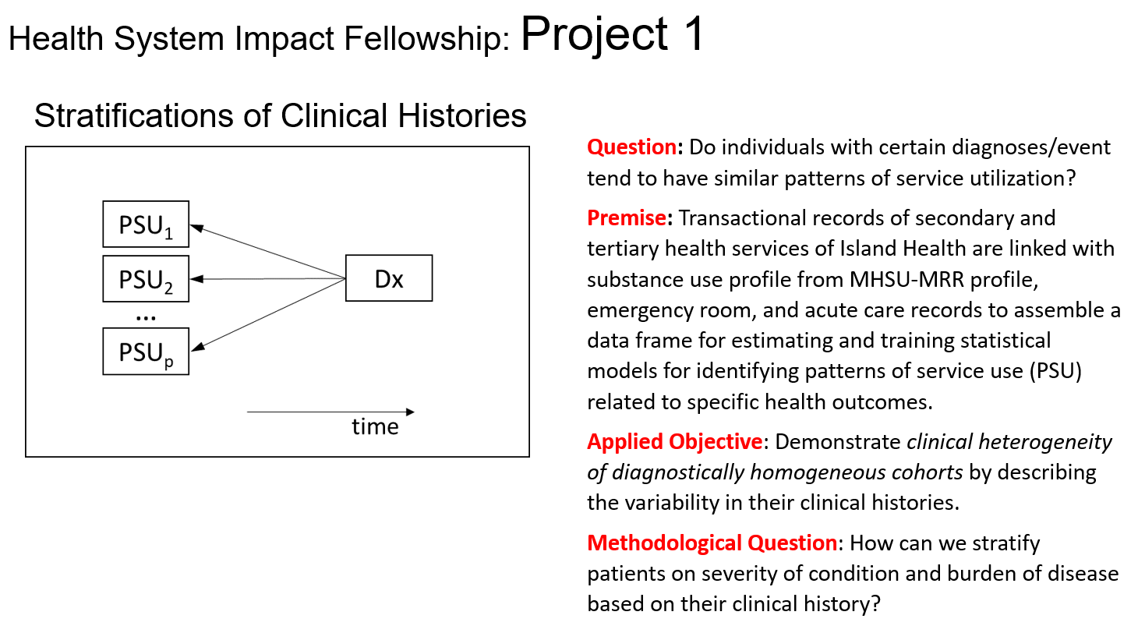

CIHR
Building on this work, Kate, Ken, and I have designed two projects for my CIHR Health System Impact Fellowship to support BCOPPH in enhancing surveillance of chronic and/or mental health and substance use (MHSU) conditions
Kate Smolina
2007
2008
2009
2010
2011
2012
2013
2014
2015
2016
2017
2018
2017

Slide 26
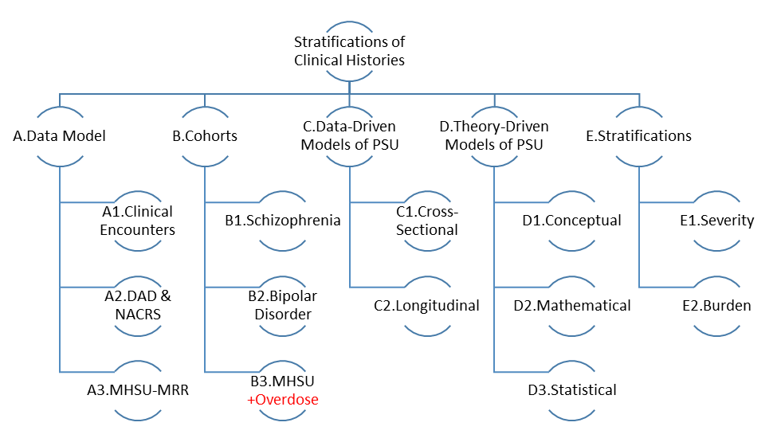
Work Break Down (WBD) structure of the proposed project
2007
2008
2009
2010
2011
2012
2013
2014
2015
2016
2017
2018
2017

